Slide 2
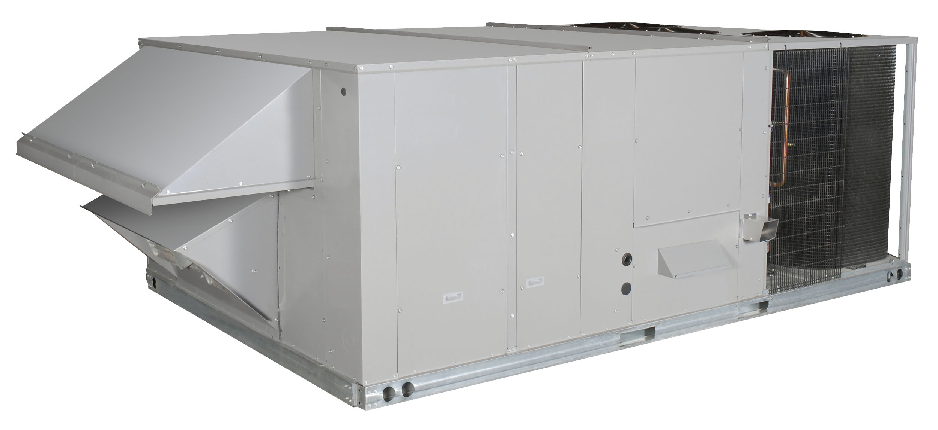
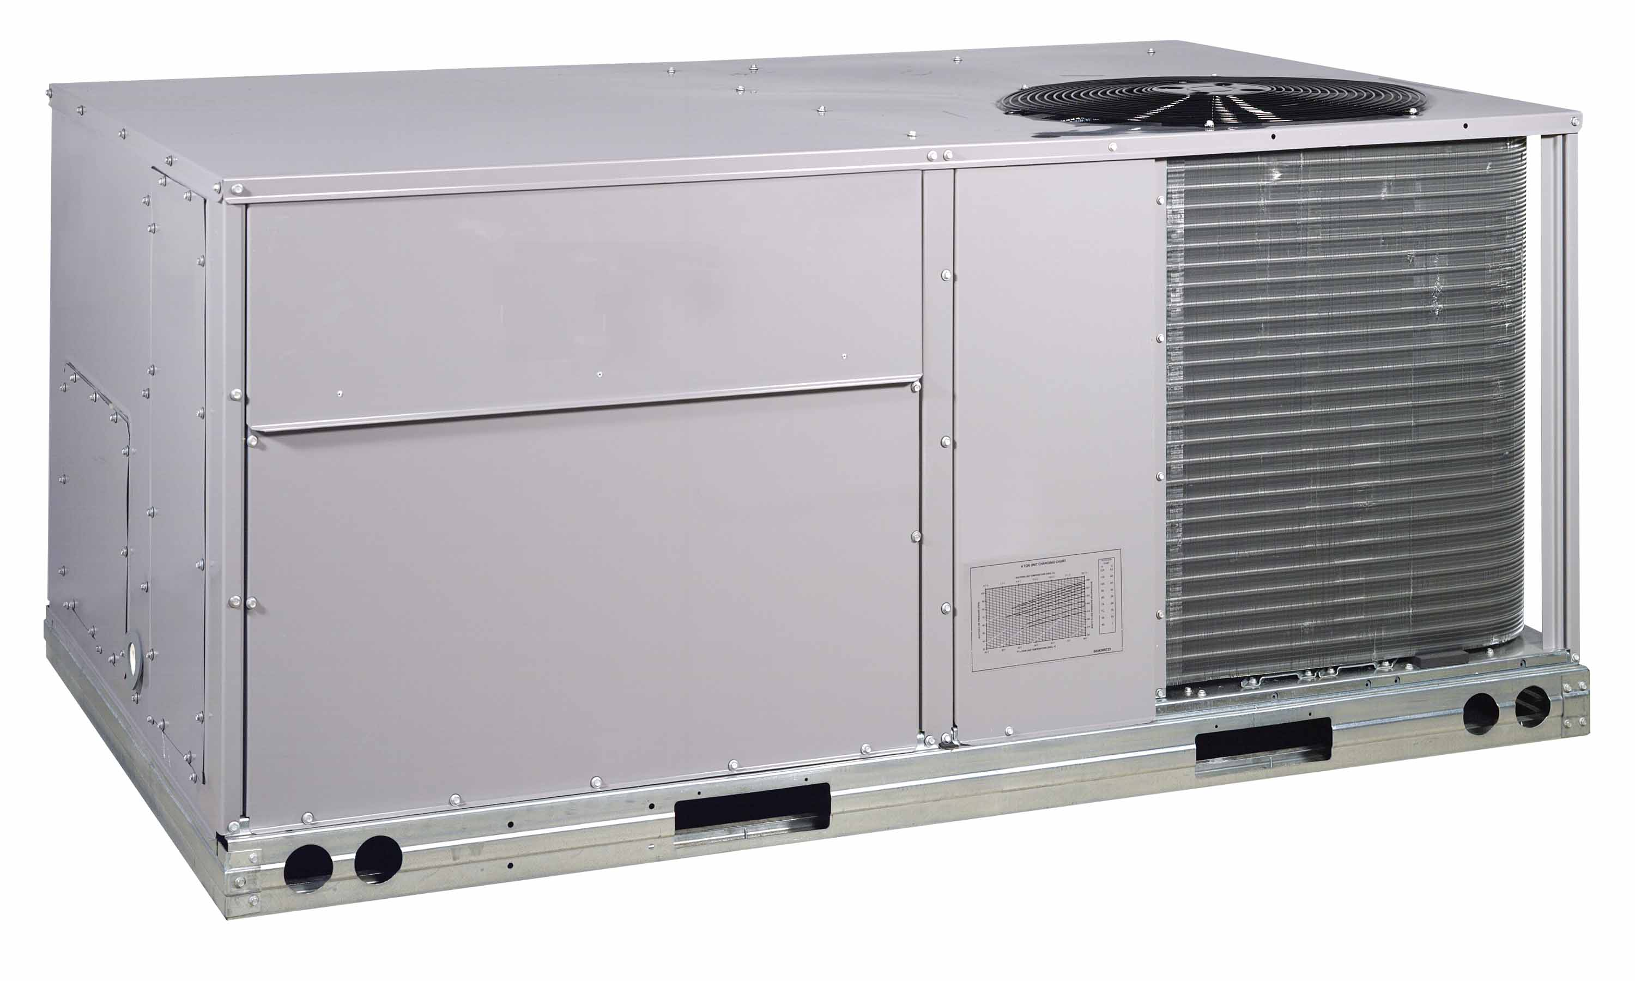

2021 LIGHT COMMERCIAL LINE UP
-C*S 6-20 Ton
-Single and Dual Circuit
-F*S 6–30 Ton
-Economizers
-NEW Extended Warranty
Splits
11.5 EER
12.7IEER
6 - 30 Ton C*S / F*S
-New Accessories
-Factory Installed Economizers
-Hot Gas ReHeat
-Single Circuit 2 Stage
-Dual Circuit 2 Stage
Package Units
12.0 EER
13.0 IEER/15.6 IEER R*H
7.5 -27.5 Ton R*H / R*S (Heat Pump up to 20 Ton)
-Full Factory Installed Options
-Wide List of Accessories
-Factory Installed Economizers
-New X-Vane HP
-New Ultra Low NOx coming!
14.0 SEER/RGW 16 SEER
15.2 IEER
3 – 6 Ton R*V / R*W Heat Pumps RHV / RHW
Notes:
Commercial offering splits 6 – 30 ton. Air Handlers have a cleanable Insulation treated with EPA Registered Antimicrobial for improved IAQ. 3 to 15 (R*S) and 3 – 12.5 (R*H) packaged units are field convertible. 17.5 – 27.5 ton (R*S) standard efficiency and 15 – 25 ton (R*H) high efficiency ships dedicated. Wide selection of factory installed options and field accessories. Hot Gas Re-Heat available on all tiers,. 7.5 – 10 ton units are offered in both single circuit 2 stage non-VFD configurations as well as dual compressor VFD units. Industry’s first patented X-Vane Platform in 3 – 6 ton gas packs, electric cool and heat pumps offered in both standard and high efficiency. Extended warranty available for both splits and packaged units.

Slide 3
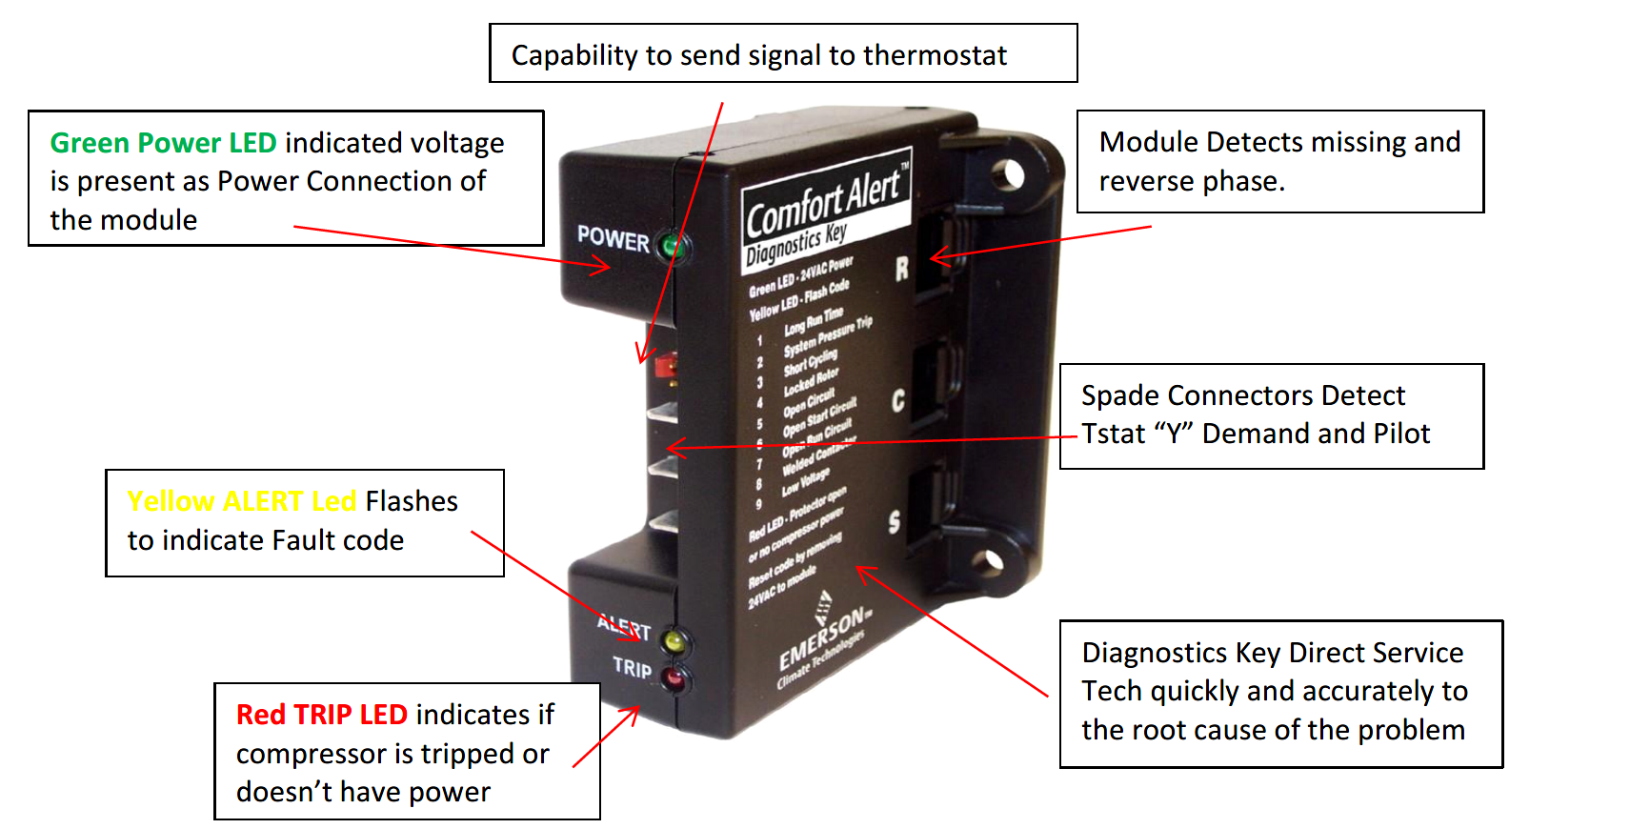
COMFORT ALERT DIAGNOSTICS
Get to the root of the problem fast!
Comfort Alert can indicate all the following:
1. Long run time
2. System pressure trip
3. Short cycling (common)
4. Locked rotor
5. Open circuit
6. Welded contactor
7. Low voltage
Notes:
Comfort Alert Diagnostics controller by Emerson. Get to the root of the problem fast! Comes standard on all condensing units. Diagnostics key allow Service Tech to quickly and accurately diagnose the problem. Saving the building owner $$ on labor and troubleshooting. Red, green and yellow indicator lights indicate power, fault codes or tripped compressor or complete power failure. The Comfort Alert diagnostics key can indicate all of the following: long run time, system tip, short cycling, locked rotor, open circuit, welded contactor and low voltage.

Slide 4

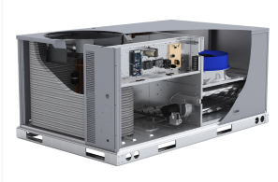
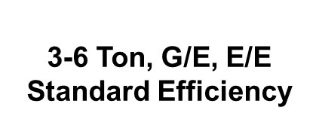
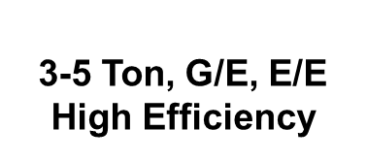
AN INDUSTRY FIRST
Industry First
Multiple Patents
Intuitive Design
Notes:
X-Vane. Industry First. Multiple patents. Intuitive design. Currently available in 3 – 6 ton gas packs and electric cool along with our newest release X-Vane heat pumps. Commercial training and videos available.

Slide 5
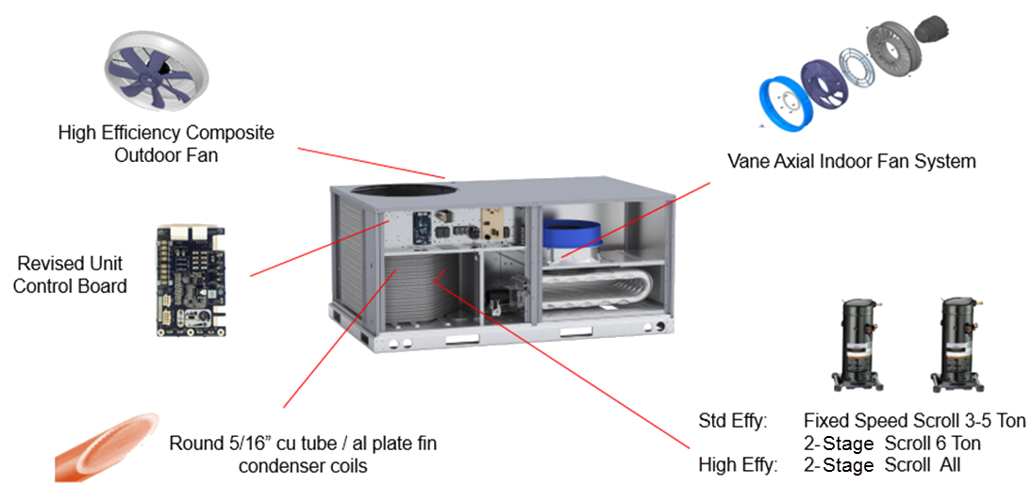

PATENTED X-VANE 3 -6 TON
Notes:
An industry first our patented X-Vane unit! The X-Vane features the vane axial indoor fan system replacing blower motor, fans and pulleys. A high efficiency and larger composite outdoor fan from 3 blade to 5 from 21” to 24” a new simple and intuitive control board for setting your fan speed along with superior round tube plate fin design. Fixed speed scroll compressor standard on 3 -5 ton and 2 stage scroll on the 6 ton. All 3 – 5 ton high efficiency units feature 2 stage scroll compressor. X-Vane videos and literature available!

Slide 6

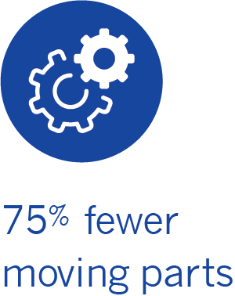
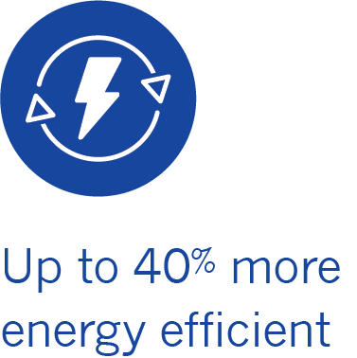


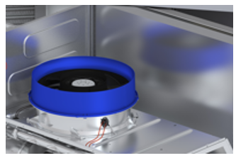
3 – 6 TON ROOFTOP
Displacing Belt Drive Design
Direct Drive ECM - Motor Design
High Impact Composite Material
Slow Speed Ramp Up
Multi Speed Fan Control w/o VFD
Permanently Lubricated Bearings
Quiet Operation
Notes:
Patented X-Vane units is up 40% more efficient. 75% fewer moving parts means reduced maintenance. Vane Axial Design displaces blower motor. No belts or pulleys to replace or adjust and no shaft or shaft bearings. Entire assembly can be disassembled and reassembled in 20 minutes. Videos available!

Slide 7
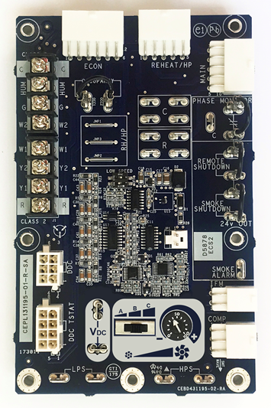
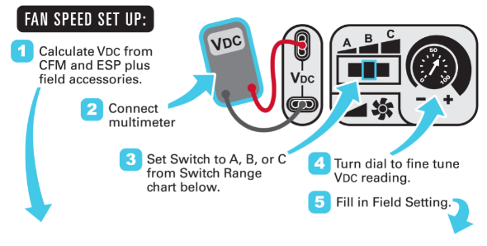
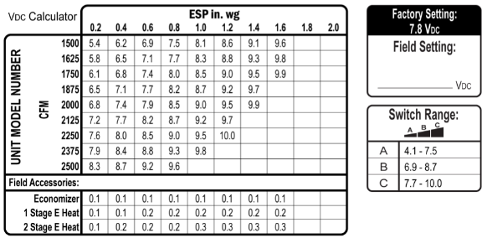
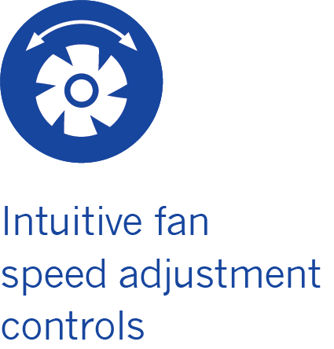
CONTROL BOARD – SET UP
NEW FAN SET – UP
No strobe light required
No amp meter (FLA) needed
No pulley / belt adjustments
No blower panel removal
NEW BOARD
(Unit Control Board)
Notes:
Intuitive fan control board set up! Set up instructions and diagram on face of control box. Know your predicted ESP and CFM use chart to find voltage then slide switch to A, B or C and fine tune the dial and you are all set! How to videos available on the GoSite and in MP4 Format.

Slide 8
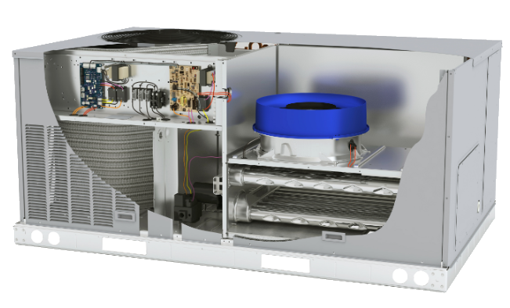
NEW HEATPUMP UNITS
Std Efficiency
3 ton – 14 SEER
4 ton – 14 SEER
5 ton – 14 SEER
6 ton – 15 IEER
RHV
Scroll Compression With Single Circuit Design
Fully Active Coil Design
2 Stage Capacity Control on Specific Models
Reliable Enhanced Round Tube - Plate Fin Coil Design
5/16” Condenser Coil Help Reduce Refrigerant Charge
Environmental Coating Options Available
Electro -Mechanical Controls
Base controls with Electro -Mechanical and Time/Temp Defrost
High Efficiency
3 ton – 16 SEER
4 ton – 16 SEER
5 ton – 16 SEER
RHW
Notes:
Built on the highly successful and patented X-Vane platform, we now offer X-Vane Heat Pumps 3 – 6 Ton standard efficiency. 6 ton RHV is a 2 stage units with a 15 IEER. The high efficiency RHW is a 2 stage 16 SEER unit. Utilizes the Ultratech scroll compressor with superior and reliable round tube plate fin coil design. Quiet with 75% fewer moving parts means less maintenance and operationally efficiency. Wide selection of factory options and field accessories available.

Slide 9


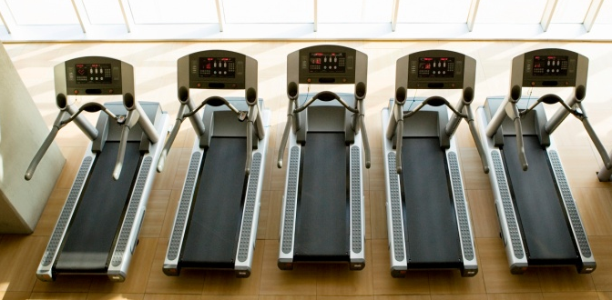
Humidi-MiZer DEHUMIDIFICATION
Competitive Advantage!
Humidi-MiZer® COIL
CONDENSER
EVAPORATOR
TXV
Factory installed
Available on all tiers
Normal, Sub-cooling & Hot Gas ReHeat
OUTDOOR AIR
INDOOR AIR
COMPRESSOR
Normal Cooling
Sub
cooling
HGRH
Notes:
Hot Gas Re-Heat is available on all tiers, both standard and high efficiency. Our hot gas re-heat provides up to 35% more moisture removal than typical conventional hot gas re-heat systems. Most competitors only offer in high efficiency and require you to use DDC Controls. Unlike our competition we offer THREE modes of reheat, sub-cooling is our specialty, allows for cooling and extra dehumidification at same time. We offer full face re-heat coil while our competition only offers split face. Factory installed. For humid applications consider our efficient hot gas re-heat models.

Slide 10

COMMERCIAL ELITE DEALER PROGRAM
BECOME AN ELITE DEALER!
Commercial units now apply towards Elite Dealer Qualification
Receive monthly Tech Tips
Online Review Management
Commercial Financing – close more jobs
Priority Dealer Locator
Create your own Custom Brochures
Commercial Dealer Training
Elite Dealer Icon Listed on Profile
Access to Elite Dealer Marketing Tools
Volume $ rebates based on qualified commercial buys!
No sign up cost or annual subscription!
Notes:
The Elite Dealer Program is now available for commercial Dealers. Same great benefits! No additional purchases required. Same eligibility requirements. Receive access to Elite Dealer Marketing Tools and create commercial brochures with your logo! Access to commercial financing and priority dealer locator with the Elite Dealer Icon listed on profile. Receive cash rebates based on volume buys. The more you sell the more you earn in rebates! Tiered rebate program gives you a path to always earn more!

Slide 11
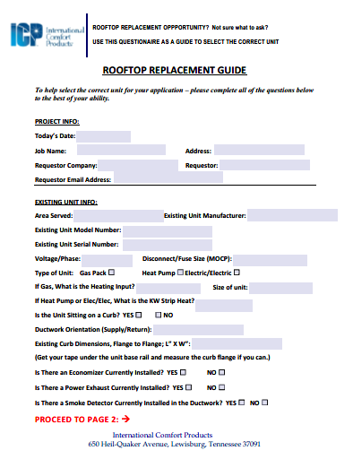
ROOFTOP REPLACEMENT GUIDE
Build the correct unit the 1st time
Ask the right questions for the job
Customer sign off – protect relationship
Fillable and in .pdf format
On the GoSite and HVAC Partners
Notes:
The Rooftop Replacement Guide ensures you ask the right questions the first time! Online on HVAC Partners and the GoSite. Easy to use and fillable in .pdf format.

Slide 12

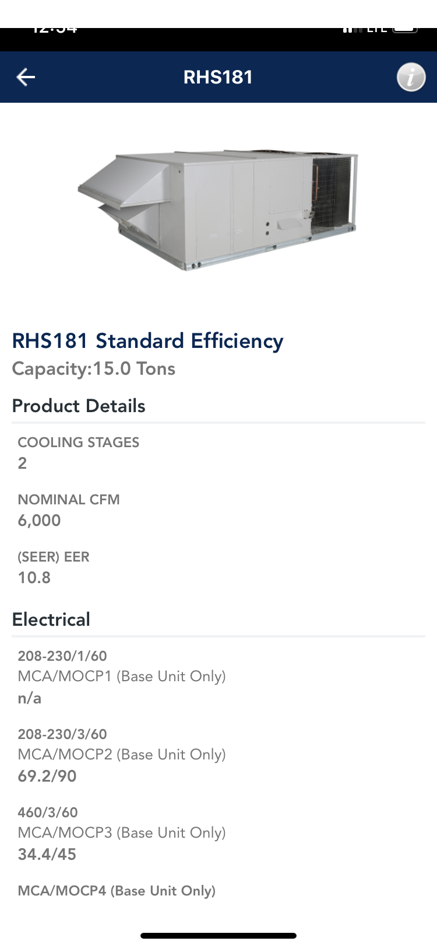
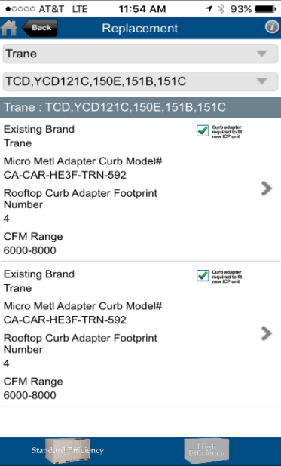
ROOFTOP MOBILE APP
On the spot selection of rooftop units
  New Construction
  Replacement
Auto Populated with Competitor Units
Advises if Adapter Curb is Required
Provides Size, Weight, Base Electrical Data
Units by Model, Size or CFM
Compare Energy Savings on Standard & High Efficiency Models
Download for FREE from Apple Play or Google!

Slide 13
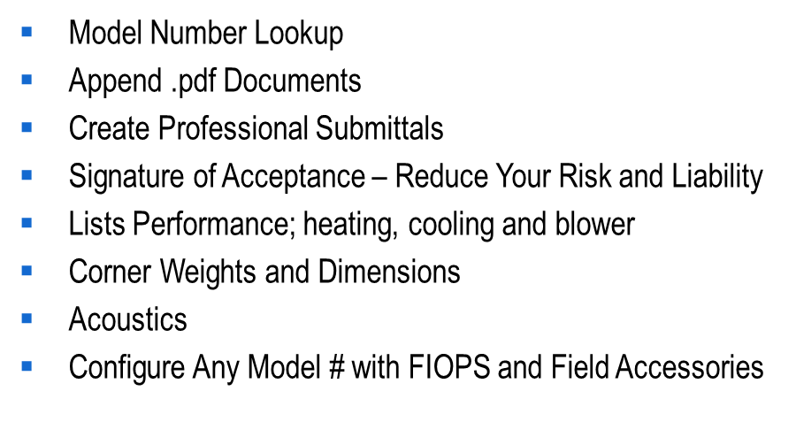
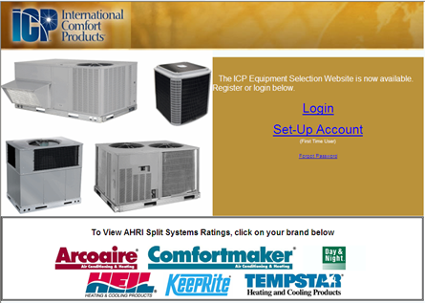

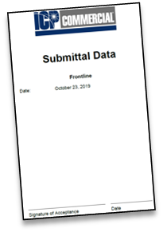
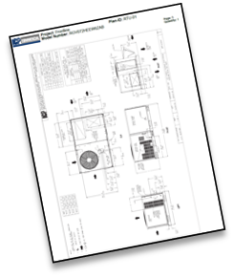
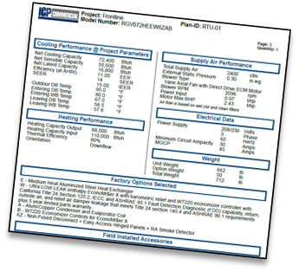
EQUIPMENT SELECTION PROGRAM
Notes:
Equipment Selection Program access on the Go Site, HVAC Partners or direct at www.icpeqp.com. Create professional submittals, create and configure a model # or look up the configuration on an existing model #. Signature acceptance allows the customer to acknowledge with the assurance needed that what is being provided is correct. Protect your relationships. Ensure you are providing the correct model the first time. Each submittal includes features, performance, corner weights, acoustics and dimensions. Easy to set up an account. Training on the tool available.

Slide 14
COMMERCIAL FINANCING
Why Commercial Finance?
Nearly 50% of contractors indicate that financing helps them close the job
Nearly 40% of business owners do not know how they will pay for the energy saving equipment they need
Perfect for unplanned replacements
Some customers will eliminate your quote if it does not include a finance option
Having the total solution of equipment and finance immediately available will win more jobs
Program Highlights
Decide on Financing up to 6 months after Install
Customizable Terms & Payments based on your Customers Seasonal Cash Flow
Applies to Leased or Purchase Equipment includes labor
No Credit Check or Cost to the Dealer
Contractor Paid within 24 – 48 hours of install
Online Payment Calculator and Credit App
Green Energy can provide total selling benefits!
Notes:
Commercial Financing offered by Green Energy. Most flexible financing program available. No cost or credit check to the dealer. Most commercial financing companies charge a $400.00 application fee. Get paid within 24 – 48 hours of install instead of waiting 30, 60, or 90! Perfect for unplanned replacements. A recent study indicated that nearly 50% of contractors indicated that offering a flexible finance program helped them win the job. And nearly 40% of owners (pre-COVID) indicated they didn’t know how they were going to pay for that energy saving equipment. At this most critical time offering a finance program on every bid provides the customer peace of mind and reassurance.

Slide 15
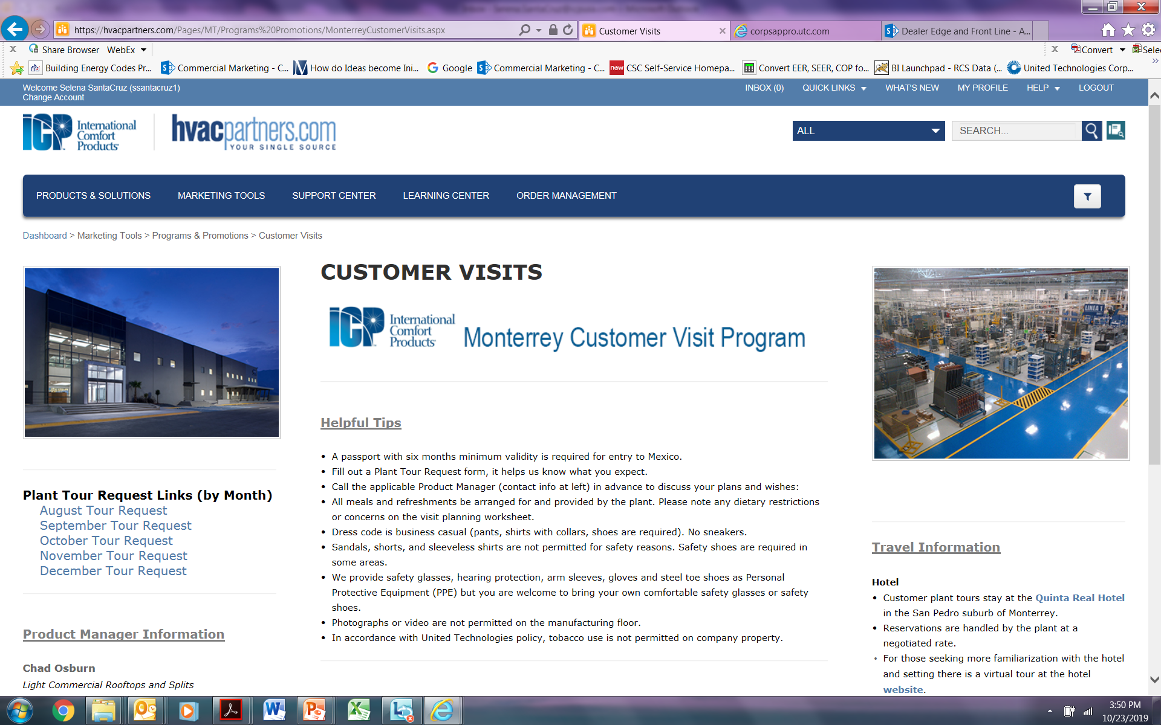
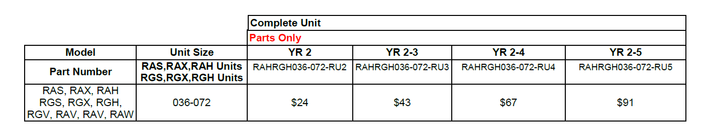
EXTENDED WARRANTY AND FACTORY TOURS
CML Extended Warranties:
Commercial Rooftop Units and Splits
Option to Purchase from 6 months of Start Up
Any 6 Ton Package Unit just $91.00 for 5 Years!
CML Factory Tours Available
Tour our World Class LEED Certified Manufacturing Facility
Notes:
Extended parts warranty now offered on all commercial splits 6 tons and above. Available on all R Series product (3 – 27.5 ton). Any R series unit up to 6 ton for 5 year warranty is just $91.00 Option to purchase up to 6 months after start up. Factory tours are available at our world class LEED Certified Manufacturing facility in Monterrey, Mexico. Convenient scheduling through your Distributor.

